Slide 1

Machine Learning with Python
Session 2: End-to-end Machine Learning Project
Arghya Ray

Slide 2
Main steps you need to go through:
Look at the big picture (what is the objective, frame the problem, what type of algorithm to use, performance measures)
Get the data (get a quick view of data using head(), info(), value_counts(), describe(),etc.)
Discover and visualize the data to gain insights (generalization error→ data snooping bias; Finding correlations)
Prepare the data for Machine Learning Algorithms (data cleansing, handling text and categorical attributes, custom transformers, feature scaling→Min-max scaling, standardization)
Select a model and train it (Split into training and testing sets, training and evaluating, Better evaluation using cross-validation)
Fine tune your model (Grid-search, Randomized search, Ensemble methods)
Present your solution (analyze the best models and their errors)
Launch, Monitor and Maintain your system

Slide 3
Data Collection and Pre-processing:
Improving the quality of data in databases for use in data-mining is a challenging task. The presence of incorrect and inconsistent data can significantly impact the result of data mining analysis and therefore potential benefits of using data-mining may not be achieved.
Usually data required for data mining tasks needs to be extracted from a number of databases, integrated and perhaps cleansed and transformed. This process is called ETL (Extraction, Transformation and Loading).
Data Cleansing is a process used to determine inaccurate, incomplete or unreasonable data items of a dataset and then improving the data quality through corrections of the detected errors and omissions.
Sources of errors in the data:
Instance Identity Errors: Same individual may be represented slightly differently in different source systems.
Data Errors: Deals with missing attribute values, duplicate records, wrong aggregations, non-unique identifiers, inconsistent use of nulls spaces and empty spaces, coding mismatch across databases, inappropriate use of address lines, etc.
Record Linkage Problem: The problem of linking information from different databases that relates to the same customer or client.
Semantic Integration Problem: Deals with errors that arise during integration of information found in different sources.
Data Integrity Problem: Data integrity deals with issues like referential integrity, null values, domain of values, etc.
Data Entry Errors: Due to unmotivated data entry staff.
Measurement Errors: Errors creep in because of instrument malfunctioning, poor calibration, or poor design of s/w used in instrument.
Filtering Errors: Each step of filtering, smoothing, and summarization of data is prone to produce errors.

Slide 4
Detecting Outliers:
An outlier is an observation that is “extreme”, being distant from the rest of the data (definition of “distant” is deliberately vague)
Different data mining software appear to include different criteria for identifying outliers.
Outliers can have disproportionate influence on models. Detecting outliers is an important step in data pre-processing.
Once detected, domain knowledge is required to determine if it is an error, or truly extreme.
Even though it is often thought that outliers should be quickly eliminated, but outliers can contain useful information. Some cases:
In a dataset about number of visas or passports issued by different offices or branches in a country, an outlier may show that too many visas or passports were issued by one agency or branch.
In a dataset of expenditure incurred by each branch of a company, many overseas trips funded by one overseas branch of a MNC.
In a computer system that has software that monitors behaviour of its users, a user’s behaviour may be found to be different than what is normally expected. This user may be flagged. Such an approach is used in what is called anomaly detection.
Finding outliers is the purpose of the DM exercise (airport security screening). This is called “anomaly detection”.
Outliers may be of different types: Univariate, Multivariate, or Time-series.
Some classify outliers are:
Global Outliers: When an outlier is significantly different from the rest of the data-points.
Contextual Outliers: When an outlier is significantly different from the rest of the data-points in the same context.
Collective Outliers: When a number of outliers are significantly different from the rest of the dataset.

Slide 5
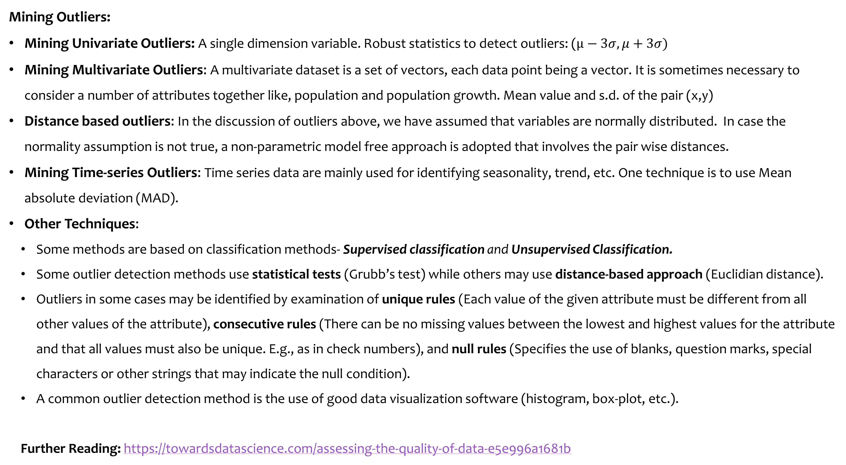
Mining Outliers:
Mining Univariate Outliers: A single dimension variable. Robust statistics to detect outliers: ($μ−3σ, μ+3σ)$
Mining Multivariate Outliers: A multivariate dataset is a set of vectors, each data point being a vector. It is sometimes necessary to consider a number of attributes together like, population and population growth. Mean value and s.d. of the pair (x,y)
Distance based outliers: In the discussion of outliers above, we have assumed that variables are normally distributed. In case the normality assumption is not true, a non-parametric model free approach is adopted that involves the pair wise distances.
Mining Time-series Outliers: Time series data are mainly used for identifying seasonality, trend, etc. One technique is to use Mean absolute deviation (MAD).
Other Techniques:
Some methods are based on classification methods- Supervised classification and Unsupervised Classification.
Some outlier detection methods use statistical tests (Grubb’s test) while others may use distance-based approach (Euclidian distance).
Outliers in some cases may be identified by examination of unique rules (Each value of the given attribute must be different from all other values of the attribute), consecutive rules (There can be no missing values between the lowest and highest values for the attribute and that all values must also be unique. E.g., as in check numbers), and null rules (Specifies the use of blanks, question marks, special characters or other strings that may indicate the null condition).
A common outlier detection method is the use of good data visualization software (histogram, box-plot, etc.).
Further Reading: https://towardsdatascience.com/assessing-the-quality-of-data-e5e996a1681b
Notes:
https://www.itl.nist.gov/div898/handbook/eda/section3/eda35h.htm

Slide 6
Handling Missing Data:
There can be a number of reasons for missing values including:
The particular data has no value associated with it.
The field was not applicable, the event did not happen, or the data was not available.
The person who entered the data did not know the right value or did not care if the value is filled in.
The value is to be provided by a later step of the process.
Most algorithms will not process records with missing values. Default is to drop those records.
Solution 1: Omission
If a small number of records have missing values, can omit them
If many records are missing values on a small set of variables, can drop those variables (or use proxies)
If many records have missing values, omission is not practical
Solution 2: Imputation
Replace missing values with reasonable substitutes
Lets you keep the record and use the rest of its (non-missing) information

Slide 7
Normalizing (Standardizing) Data:
Used in some techniques when variables with the largest scales would dominate and skew results
Puts all variables on same scale
Normalizing function: Subtract mean and divide by standard deviation (used in XLMiner)
Alternative function: scale to 0-1 by subtracting minimum and dividing by the range
Rare event oversampling
Often the event of interest is rare. Examples: response to mailing, fraud in taxes, etc.
Sampling may yield too few “interesting” cases to effectively train a model
Popular solution: oversample the rare cases to obtain a more balanced training set. Later, need to adjust results for oversampling.
The Problem of Over-fitting
Statistical models can produce highly complex explanations of relationships between variables.
The “fit” may be excellent. But when used with new data, models of great complexity do not do so well.
Causes:
Too many predictors
A model with too many parameters
Trying many different models
Consequence: Deployed model will not work as expected with completely new data.
To handle the problem of over-fitting, we need to go for validation and testing.

Slide 8
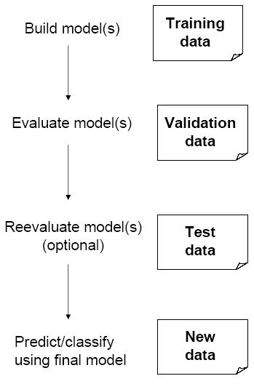
Partitioning the Data:
Problem: How well will our model perform with new data?
Solution: Separate data into two parts.
Training partition to develop the model
Validation partition to implement the model and evaluate its performance on “new” data.
Test Partition
When a model is developed on training data, it can overfit the training data
(hence need to assess on validation)
Assessing multiple models on same validation data can overfit validation data.
Some methods use the validation data to choose a parameter.
This too can lead to overfitting the validation data .
Solution: final selected model is applied to a test partition to give unbiased estimate of its performance on new data

Slide 9
The content of the slides are prepared from different textbooks.
References:
Links:
https://www.sas.com/en_in/insights/big-data/what-is-big-data.html
https://www.oracle.com/big-data/what-is-big-data/
https://www.w3schools.com/python/python_variables_multiple.asp
Predictive Analytics for Dummies, By Anasse Bari, Mohamed Chaouchi, & Tommy Jung, Copyright 2016, John Wiley & Sons, Inc.
Introduction to Data Mining with Case Studies, By G.K. Gupta. Copyright 2014 by PHI Learning Private Limited.

Slide 10

Thank you..

